Slide 1
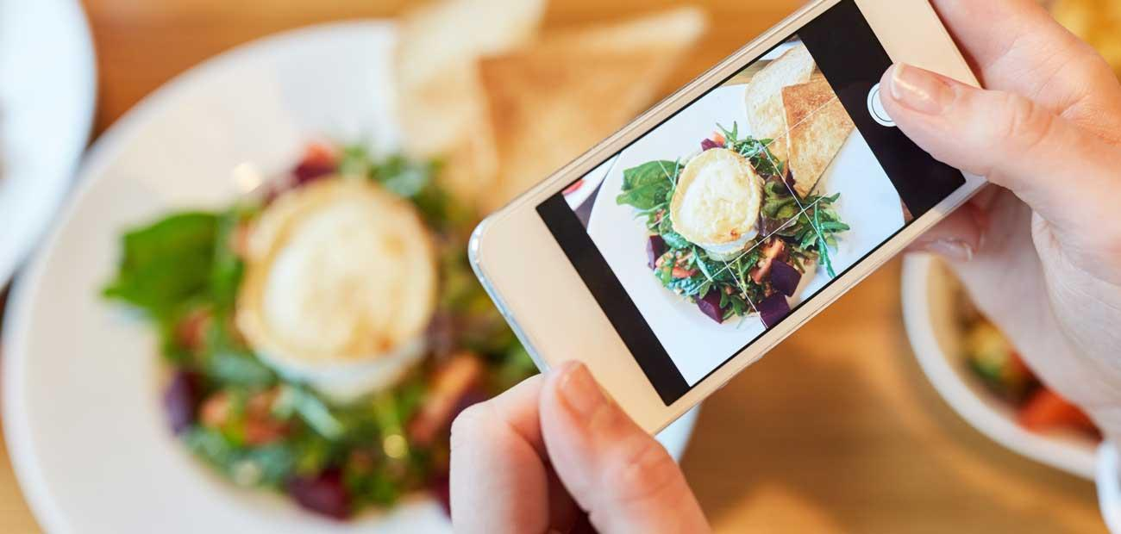
Food Tales: A Food Blogging App
User Experience Design & Testing
Final Presentation
Team Members:
Anusha Poojary- 002114479​
Ankita Senapati- 001003695​
Merwin Roy- 002959569​
Surbhi Parihar- 001597188​
Krishna Pal Singh- 002954173

Slide 2
Contents
Slides | Topics
3 | Project Overview
4-5 | Problem Statement and Solutions
6-8 | Style Guide
9-11 | Product Objectives
12-18 | Personas and Use Cases
19-20 | Target Audience
21-22 | Design Process
23-34 | User Needs
25-28 | Research Methods
29-31 | Card Sorting
32-34 | Information Architecture
35-37 | Error Handling
38-39 | Usability Testing Objectives & Tasks
40-41 | The Five Planes
42-44 | Onboarding

Slide 3

Overview
Proposed a UI/UX design and testing project for a food blogging web application. ​
​
With wide, ubiquitous presence of food delivery and blogging applications. We wanted to present an application with an unrivalled interface that will provide a seamless, transparent user experience which is conducive to deliver user needs efficiently, resulting in user retention to the application for posting food pics, recipes, food/restaurant reviews and ratings, suggestions, tips and much more.

Slide 4
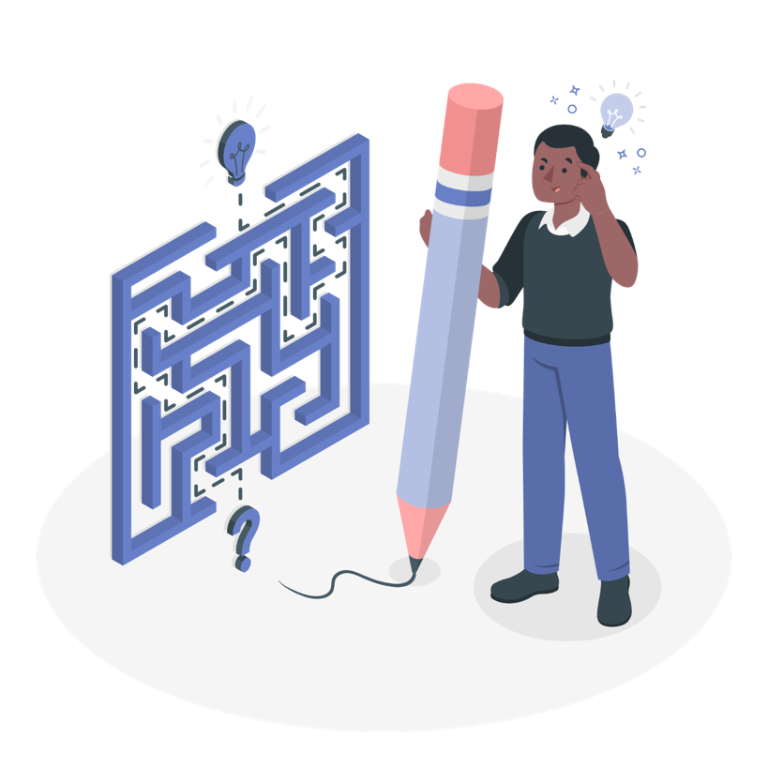
Problem Statement

Slide 5
Problem Statement & Solutions
Bloggers have a difficult time in finding a platform, especially for something as niche as food blogging. The application helps bloggers and other stakeholders connect.​
Users on a time crunch have difficulty following a recipe for meal preparation, the platform can provide step by step guidance for a variety of cuisines.​
The platform can become a common yet reliable interface for restaurant/cuisine reviews and recommendations.​
There are few platforms that provides discourse pertaining to culinary field, which “Food Tales” fulfills.​
The app helps users by providing a one-stop platform for blogging, restaurant reviews, food hacks and healthy food habits.

Slide 6
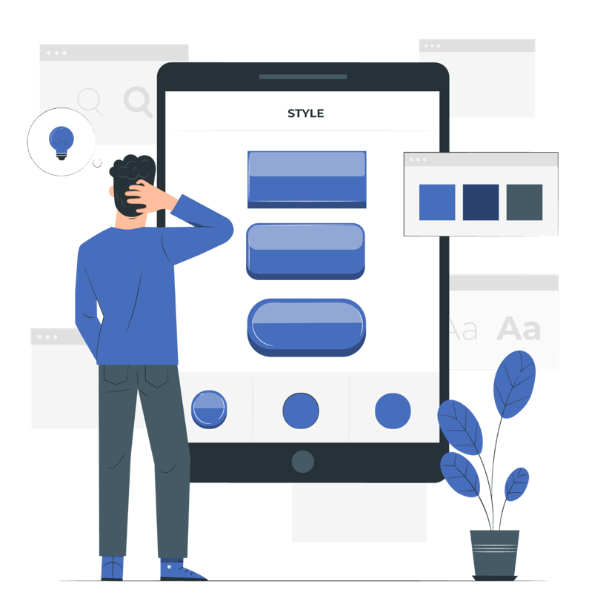
Style Guide

Slide 7

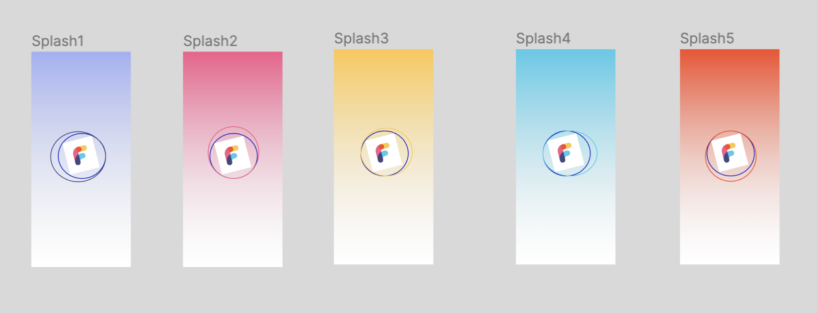
Logo Used
Color Palette
Dimension: 48px x 48px
#5D5AF6
#9C9BDD
#D9D9FF
#5D5AF6
Typography:
Page Headers: Roboto, Regular, 32px
Button Text: Roboto, Medium, 14px
Onboarding Headers (Headline 6): Roboto, Medium, 20px
Iconography:
Home, Settings, Left Angle, Right Angle, Map, Bold, Italic, Smiley, etc

Slide 8
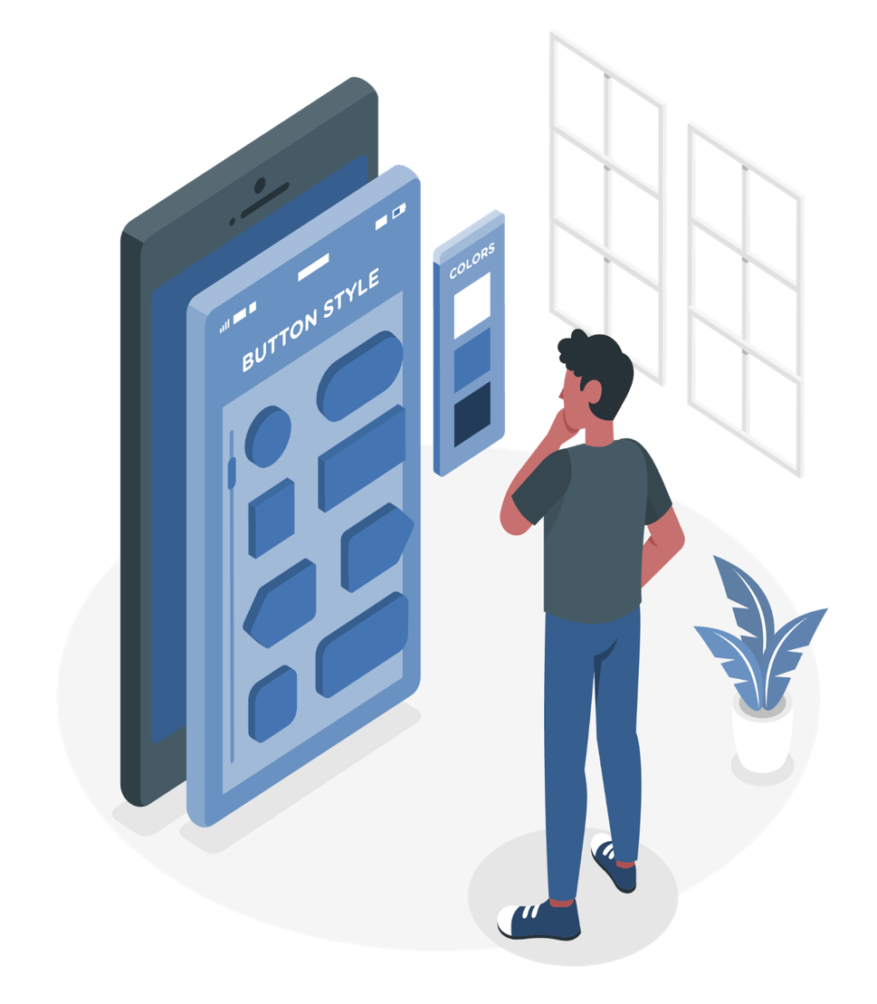
Navigation Menu:
Color:
Active Icon: 100% opacity
Inactive Icons: 50% opacity
#D9D9FF
Buttons:
Color:
Active Icon: 100% opacity
Inactive Icons: 50% opacity
Selected Button: Used Drop and Inner Shadow to provide depth effect.
#5D5AF6
#9C9BDD

Slide 9

Product Objectives

Slide 10
Explore: Allow users to explore restaurants, blogs, cuisines seamlessly
Integrated Platform: Provide an integrated platform for a variety of users who share different types of food interests.
Marketing: Provide bloggers an opportunity to market and publicize their blogs.
Optimize Blogging Experience: To optimize the overall blogging experience by allowing users to upload high quality pictures, seamless navigation, connecting with other bloggers.

Slide 11
Customer Satisfaction: Allowing users to provide feedback to focus on customer satisfaction
Connecting Users: Allow users to follow their favorite bloggers to see more posts from them
Generate More Sales: Promote blogs to attract customers thus helping business to generate more sales
Increasing Healthy Food Awareness: Encouraging users to undertake a healthy lifestyle

Slide 12

User Personas

Slide 13
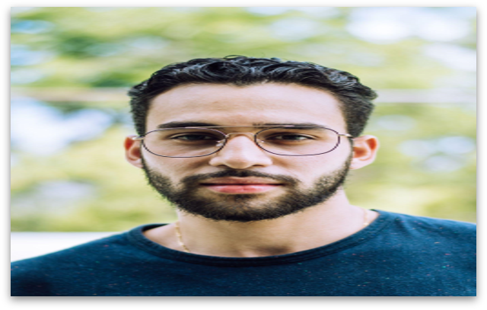
USER PERSONA 1:
James Roe
ABOUT USER
“I like to travel a lot, and it gets difficult to find good places to eat”​
James is a youngster for whom making a style statement means a lot and is looking for the right online marketplace to buy his apparel from.​
GOALS AND FRUSTRATIONS​
Name: James Roe​
Age: 19​
Occupation: Travel Vlogger​
Household Income: 20000$ / year​
Technical profile: proficient with technology, Uses a Macbook, 100 mbps internet connection.​
Internet use: 30% mobile internet, 60% public internet
Favorite sites: Pinterest, Instagram​
GOALS:​
James wants to try the best local cuisine when he visits a new town.​
He can invest his time and effort reading through the blogs and then explore that restaurant.​
FRUSTRATIONS:​
James is frustrated because google reviews are misleading sometimes and are too commercial to be trusted.​

Slide 14
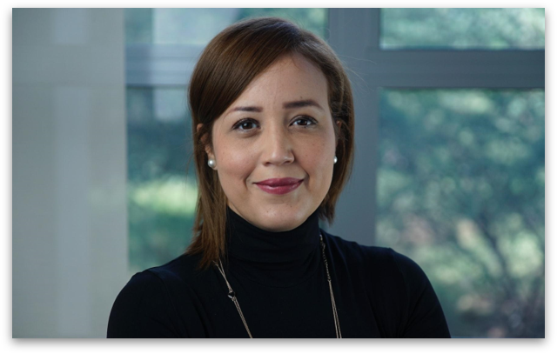
USER PERSONA 2:
Janet Monahan
ABOUT USER
“I like to write in my free time, I write poems, columns and blogs.”​
Janet is a lawyer who has the hobby of writing poems, letters, editorial columns, entertainment and food blogs.
GOALS AND FRUSTRATIONS​
Name: Janet Monahan
Age: 35
Occupation: Lawyer
Household Income: 125000$ / year​
Technical profile: proficient with technology, Uses a Macbook, macOS Monterey, 100 mbps internet connection.​
Internet use: 30% mobile internet, 60% public internet​
Favorite sites: Pinterest, Instagram​
GOALS:​
Janet wants to write food blogs sharing her recipes and secrets to her healthy recipe ideas.
FRUSTRATIONS:​
Janet is frustrated when she cannot find the right audience for her blogs.

Slide 15
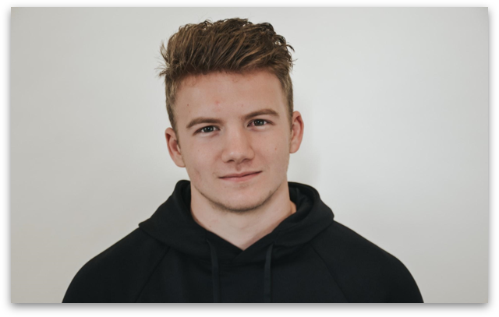
USER PERSONA 3:
Peter Anderson
ABOUT USER
“I like to work out a lot and go to the gym regularly. I prefer maintaining a healthy diet”​
Peter is a part-time student and a gym instructor. He enjoys healthy food and wants to make sure all his friends follow a similar healthy diet.​
GOALS AND FRUSTRATIONS​
Name: Peter Anderson
Age: 24
Occupation: Part-time student, Gym Instructor
Household Income: 50000$ / year​
Technical profile: Proficient with technology, uses a windows desktop​
Internet use: 80% mobile internet, 20% public internet​
Favorite sites: Eating Well,, Instagram​
GOALS:​
Peter wants to promote healthy food eating habits and therefore wants to write blogs and promote restaurants serving healthy food.
FRUSTRATIONS:​
Peter gets upset when he sees good restaurants serving healthy food do not get promoted very well and lose business.

Slide 16
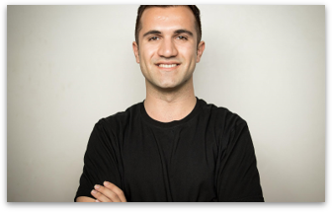
USER PERSONA 4:
John Fernandez
ABOUT USER
“I want to expand my business based on user needs”​
John is a restaurateur who wants to expand his small business and wants insight on the cuisine and user requirements that influence their decision to order food item from a particular restaurant.​
GOALS AND FRUSTRATIONS​
Name: John Fernandez
Age: 35
Occupation: Restaurateur
Household Income: 90000$ / year​
Technical profile: Comfortable with technology, Uses a windows laptop, 100 mbps internet connection.​
Internet use: 60% mobile internet, 40% public internet​
Favorite sites: Ebay, Doordash
GOALS:​
Promote my restaurant, food hacks, thus attracting more crowd. Understand customer needs via comments.
FRUSTRATIONS:​
Food blogging websites and applications put very little emphasis on business owners who want to understand the business trends and expand their business accordingly.​

Slide 17
Use Cases
Actor​ | John Fernandez
Use Case​ | Write food blogs about his restaurant
Description​ | John wants to write blogs to share her family recipes and to provide tips to users for easy recipes.​
Pre-Condition​ | John must sign up in the application to write a food blog. If already a registered user, he must have internet to post the blog.
Basic Flow​ | Login to the application, go to dashboard. At the bottom, there are 4 menu options, click on the 2nd option from left to navigate to the Blogs page. From the available options, select Write Blogs option. Enter basic blog details. In the new page, write the post, add pictures and click on Post for review button.​ Navigate to My Blogs to view and track the status of the posted blog.
Alternate Flow | After the posted blog is approved by Admin, John can promote his blog by paying a small amount. The promote button against each blog can be used for the same.

Slide 18
Use Cases
Actor​ | Peter Anderson
Use Case​ | Read food blogs promoting healthy eating habits
Description​ | Peter wants to read food blogs.
Pre-Condition​ | Peter must have the app and internet to access it.
Basic Flow​ | Login to the application, go to dashboard. The app’s Guest Browsing feature allows Peter to browse through food blogs, read them in details. He has no access to add comments or rate posts.
Alternative Flow | Sign up in the application. Browse through blogs under the various categories. Open the blogs to read in detail. Registered user can rate and add comments as well.

Slide 19
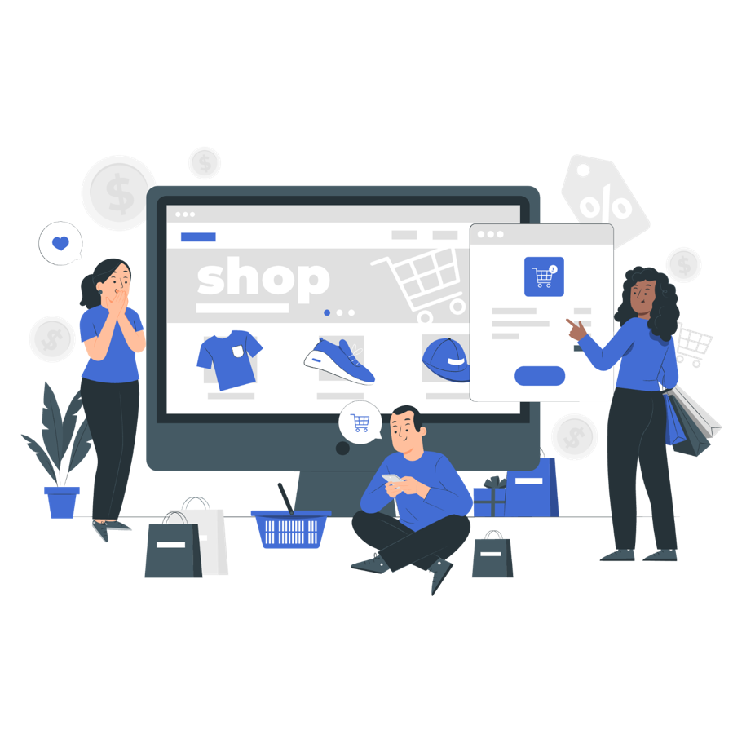
Target Audience

Slide 20
Food Photographers: Users can post high definition food photos and earn likes, shares and subscribers. It can help such users to promote their work and gain wide user base.​
Blog writers: Users who are fond of writing blogs can post food related blogs on this platform. They can gain insights from other bloggers using the platform.​
Restaurateurs: Users who own/manage business can check trends based on blog posts, analytical information such as likes, shares on posts, popular bloggers and their content for business decision making, promotion etc.​
Customers: Users who want to try out new cuisine/ restaurants can read comments/reviews/ratings of cuisine or restaurants beforehand.​
Cooking Enthusiasts: Users who seek interest in cooking new recipes can do so by following recipes posted on the platform.​
Fitness Enthusiasts: Users who are gym trainers, fitness enthusiasts, can find a separate section dedicated to them

Slide 21

Design Process

Slide 22
Discover
User Survey
Define
Problem Statement, User Personas, Comparative Analysis
Brainstorm Sessions, Card Sorting, Information Architecture
Ideate
Wireframe, Interactive Prototype
Design
Validate
Usability Testing, Prototype Testing

Slide 23
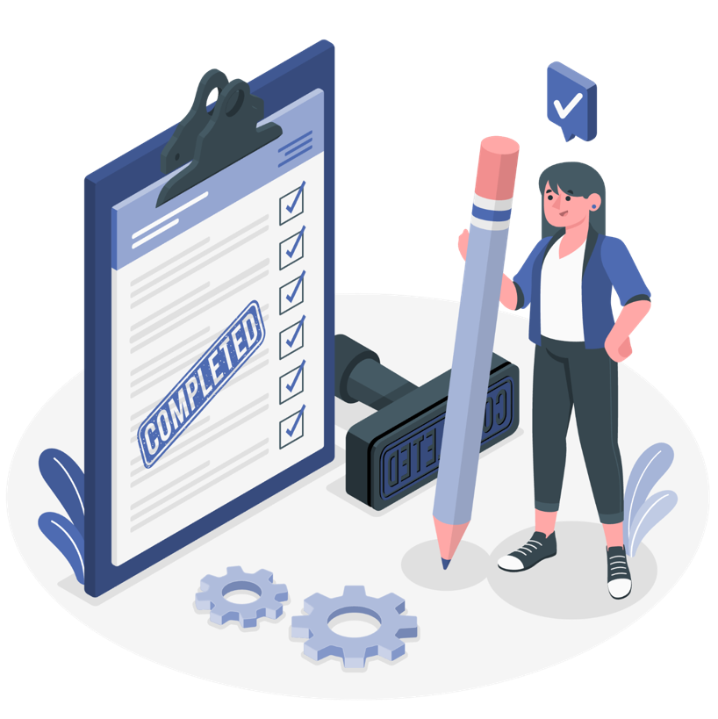
User Needs

Slide 24
Users should be able to post quality pictures of food and restaurants, and write quick description, recipes, etc seamlessly.
Users should find it easy to navigate through the platform to search restaurants, cuisines, recipes and filter requirements accordingly.​
Users should be able to browse through blogs even if they are not signed in.
Users should be able to follow their favorite bloggers so that they can see more posts from that author.
Users should be able to promote their blogs to target a larger audience.
Users should be able to see list of users they follow and the ones who follow them.
Users who are registered in the application, should be able to rate the blogs and comment on them.

Slide 25

Research Methods

Slide 26
Interactive Prototyping
Usability Bug Review
Created product prototype using Figma tool to help visualize,understand and test
product design, interactions and flows.
Defined 4W’s of evaluation (Who,What,Why,Where) to walk through each scenario and keep track of features and functions of the product.

Slide 27
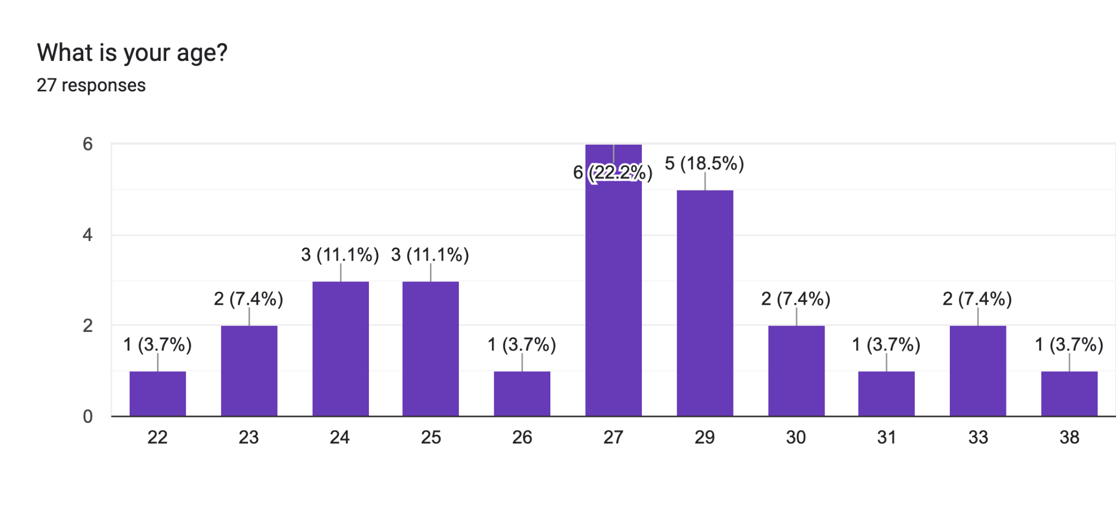
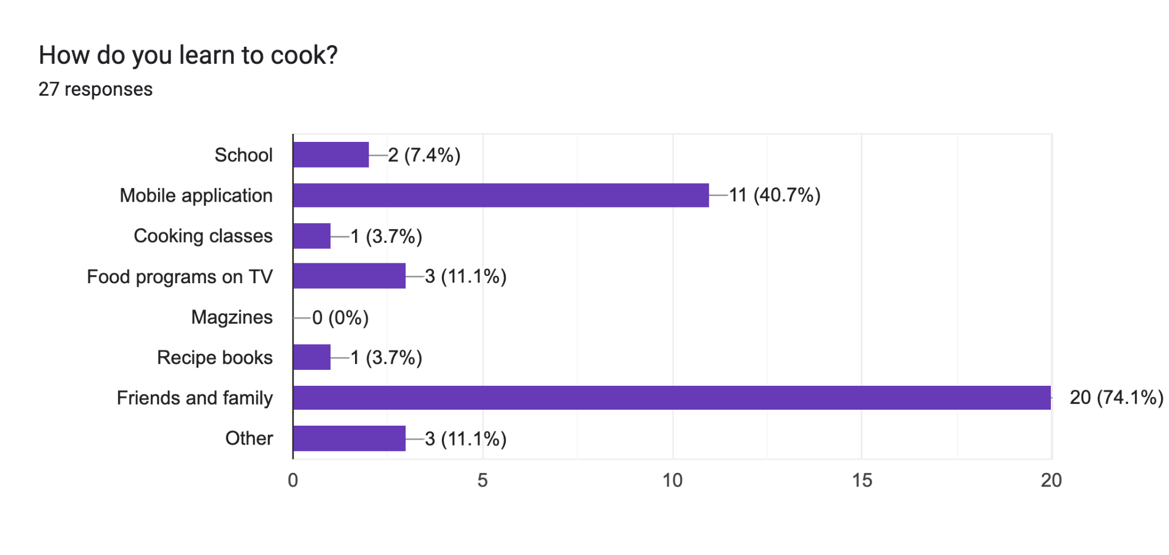
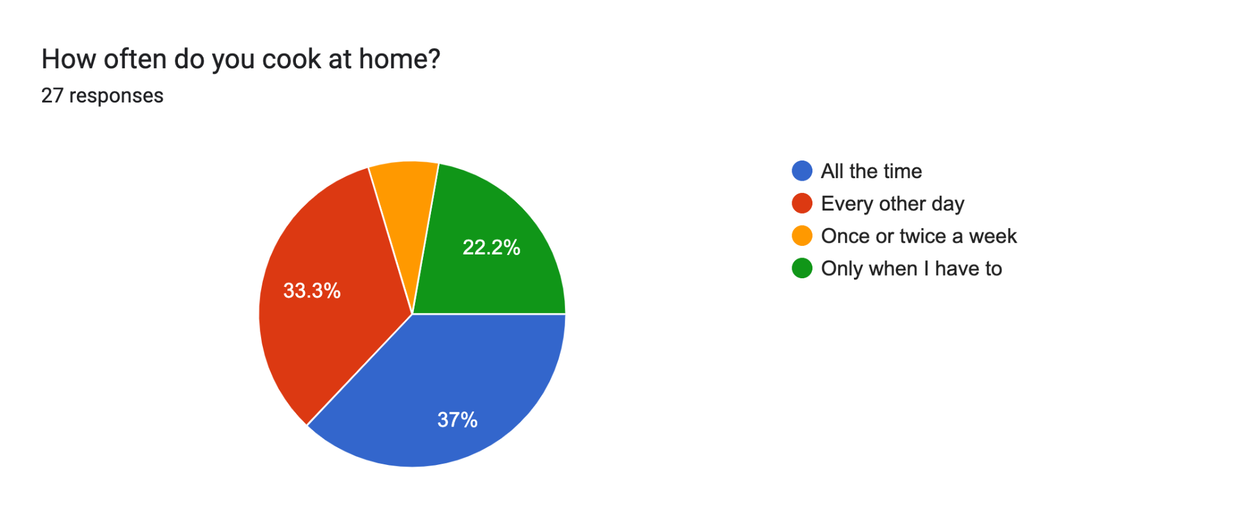
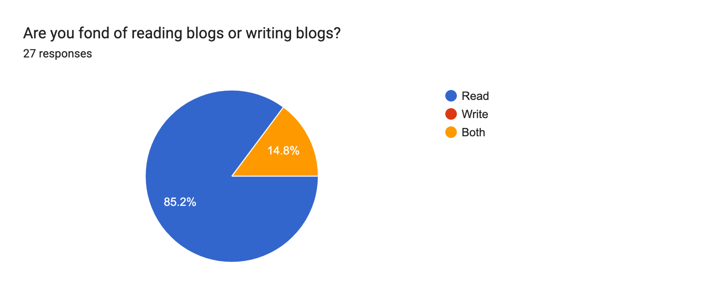

Slide 28
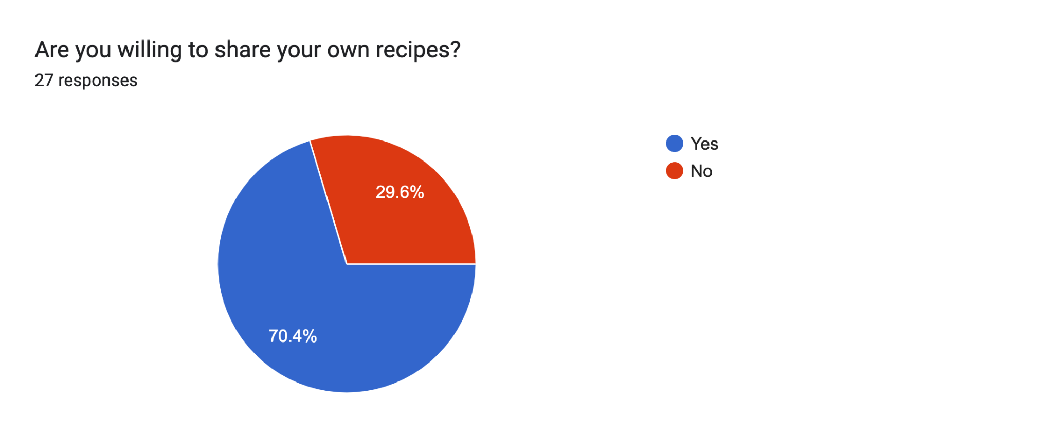
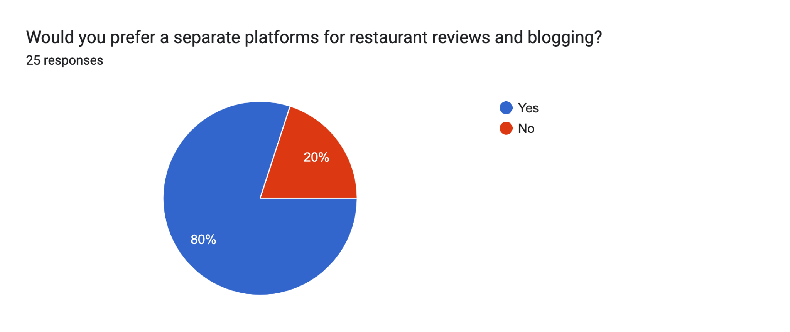
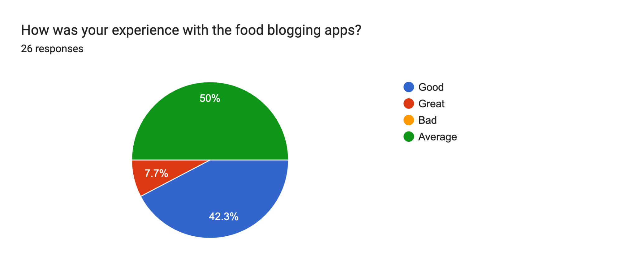
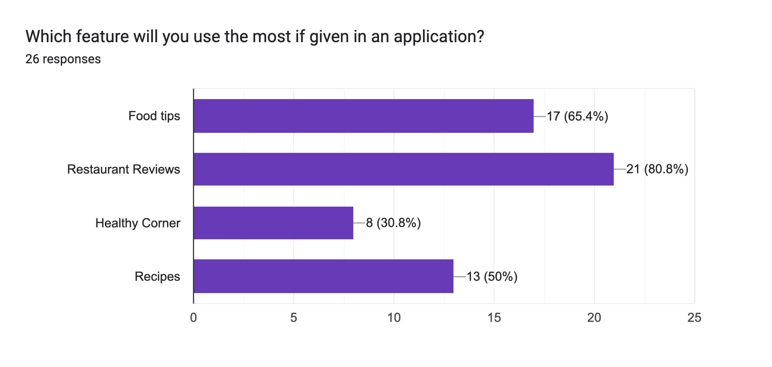

Slide 29
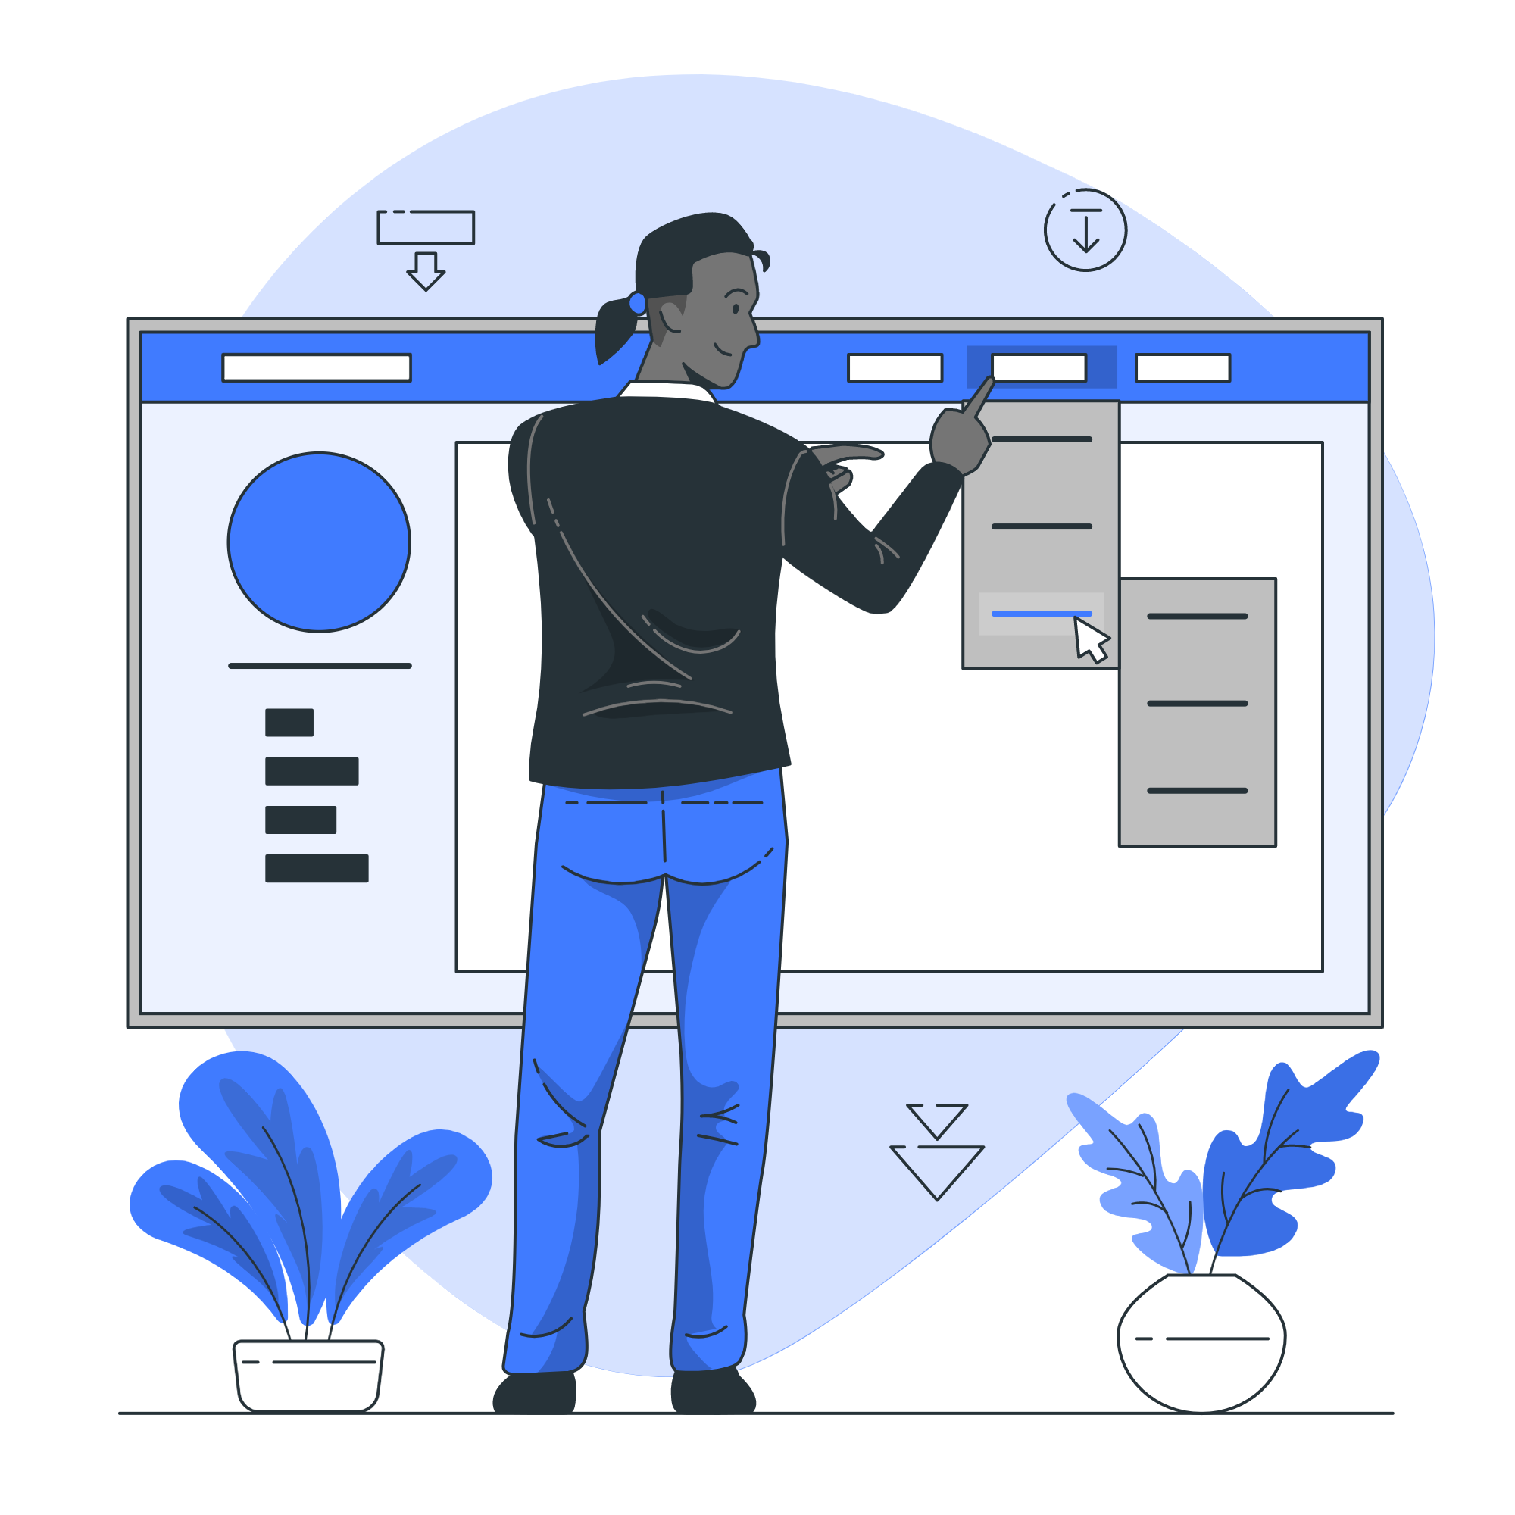
Card Sorting

Slide 30
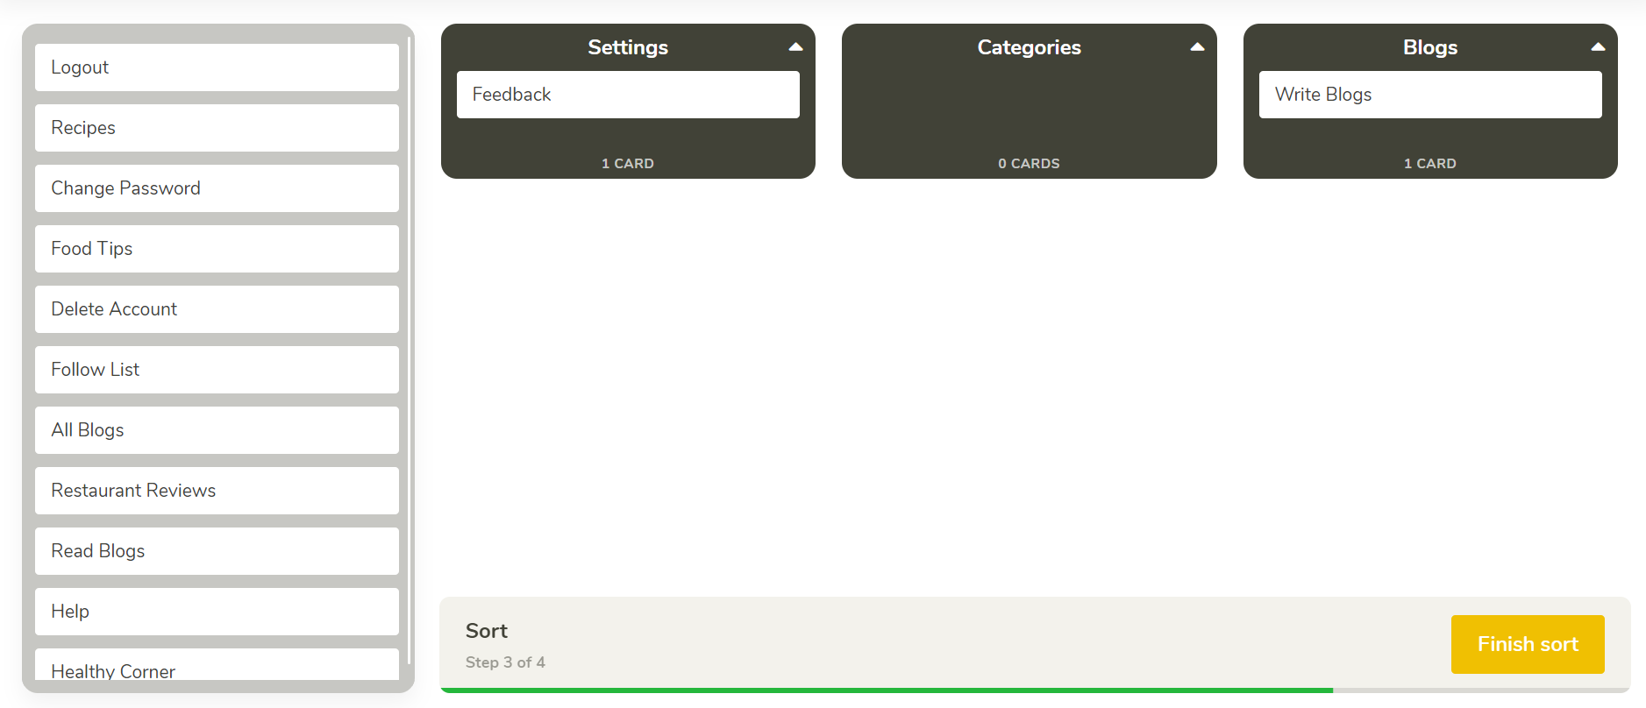
Closed Card Sorting

Slide 31
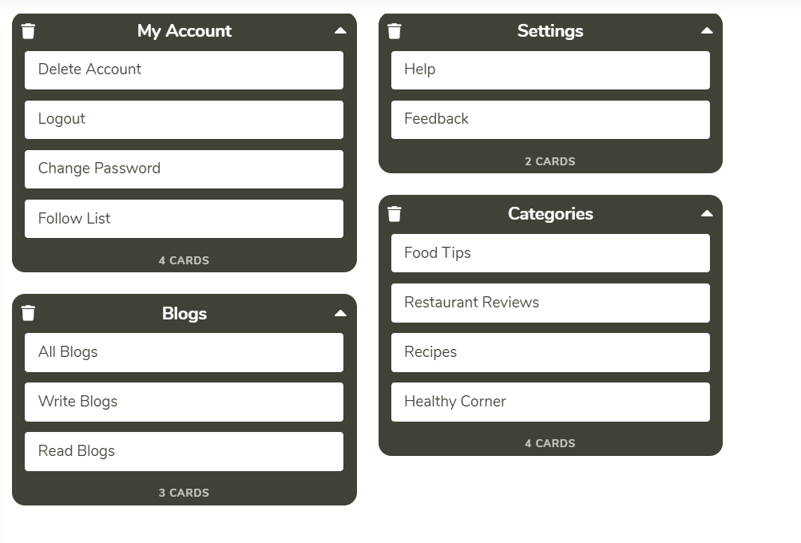
Open Card Sorting

Slide 32
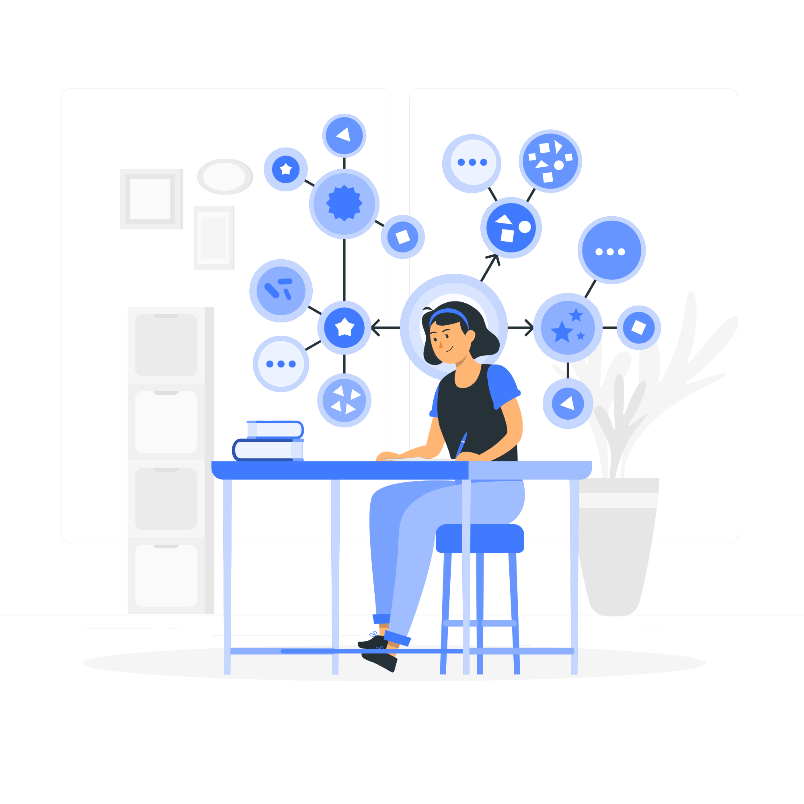
Information Architecture

Slide 33
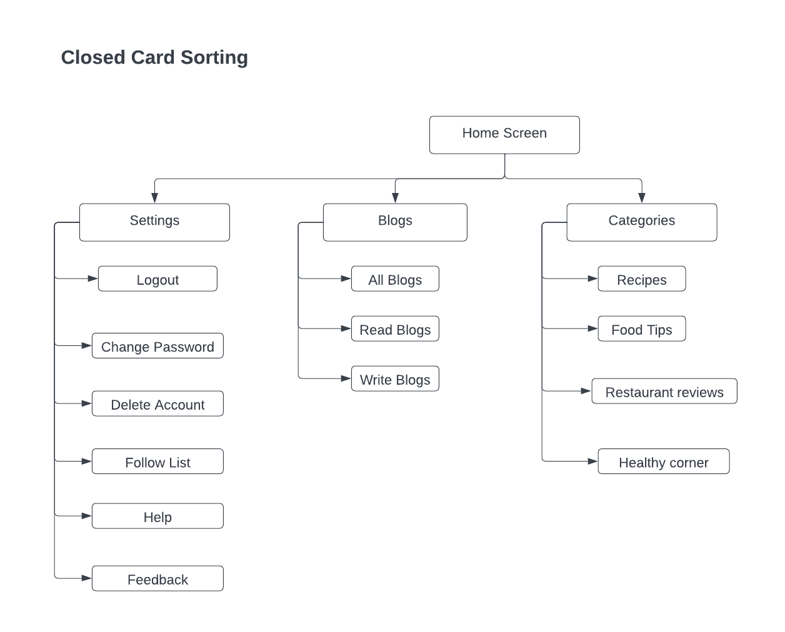
Closed Card Sorting- IA

Slide 34
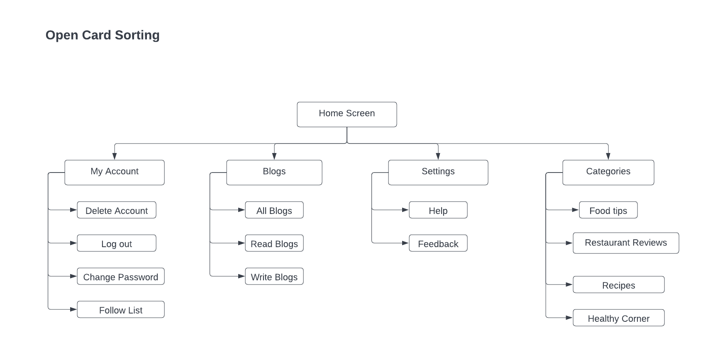
Open Card Sorting- IA

Slide 35
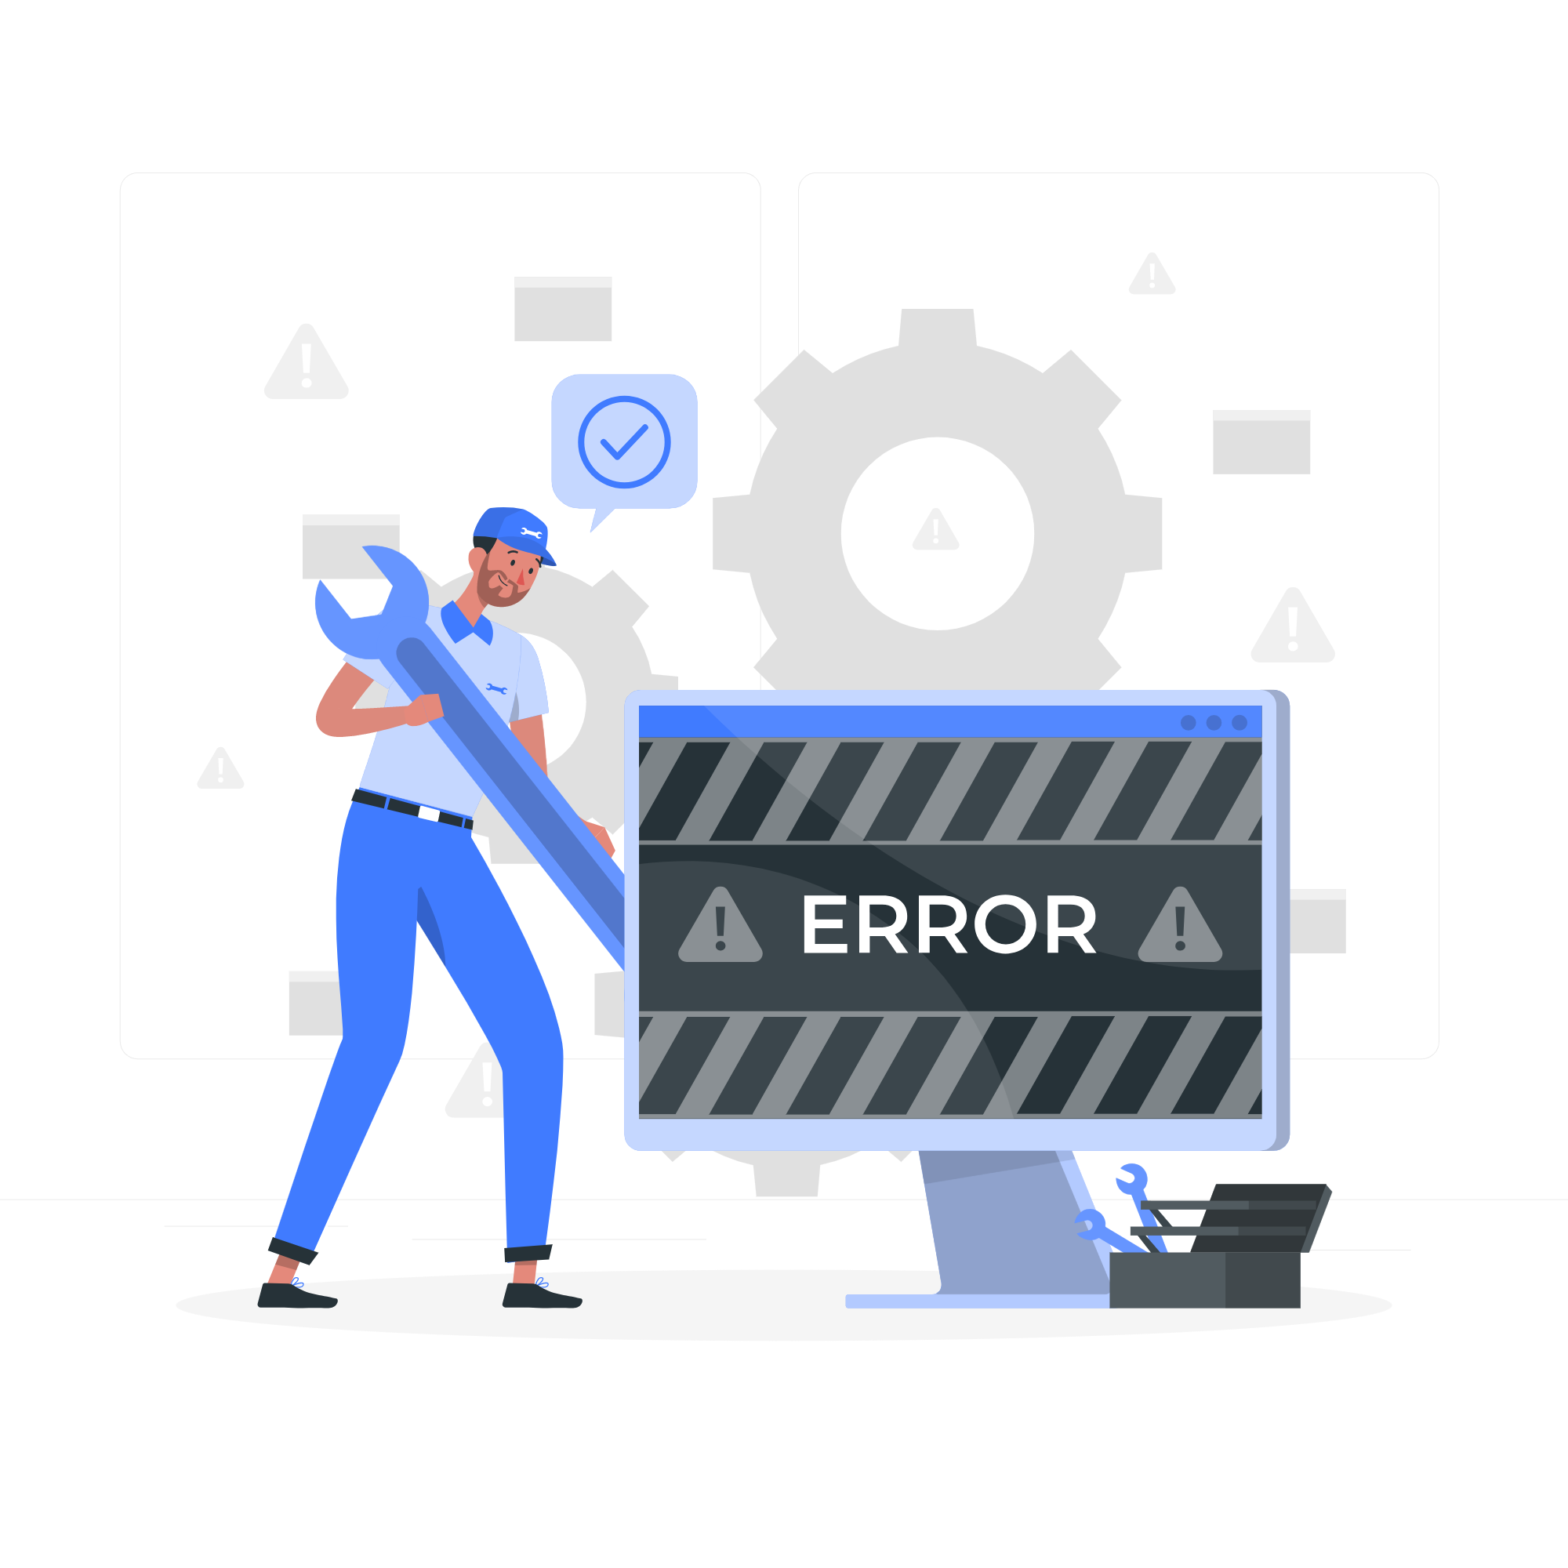
Error Handling

Slide 36
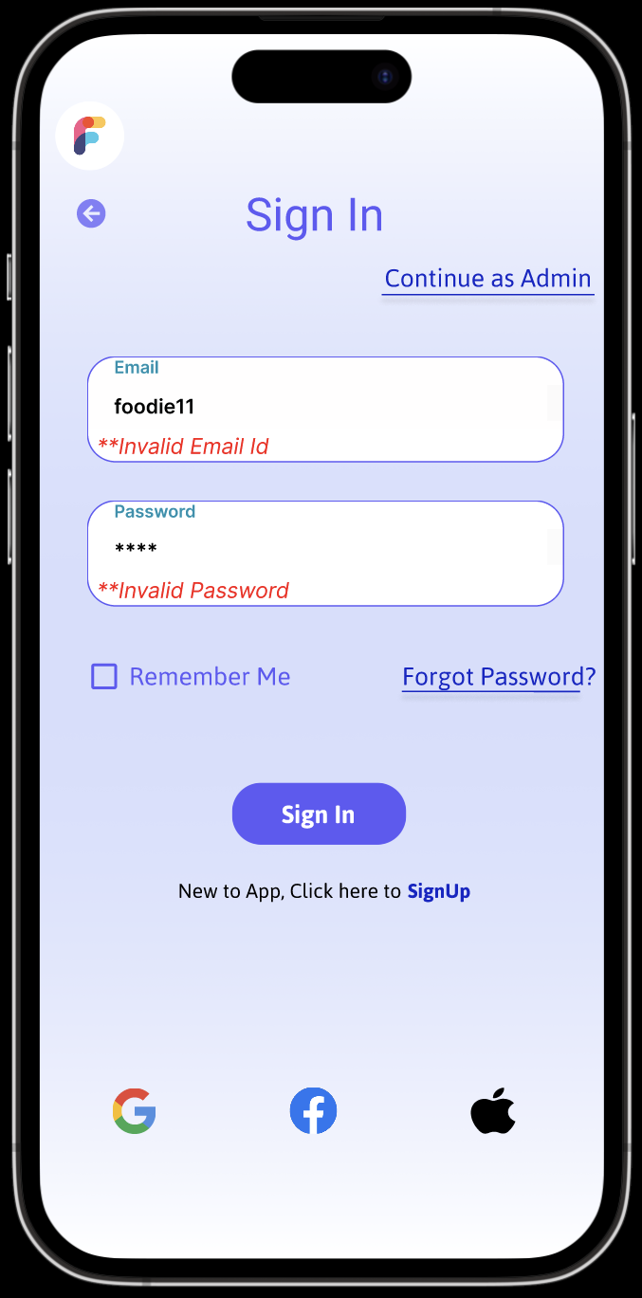
If user presses key ‘W’, it would show the error messages. For example, in real case scenario, if the Email is incorrect, it would give an error message as ‘Invalid email Id’.User needs to press ‘delete’ to get rid of the error.
The ‘V’ key represents the correct information. And once you press ‘Enter’, it would go to next value.

Slide 37
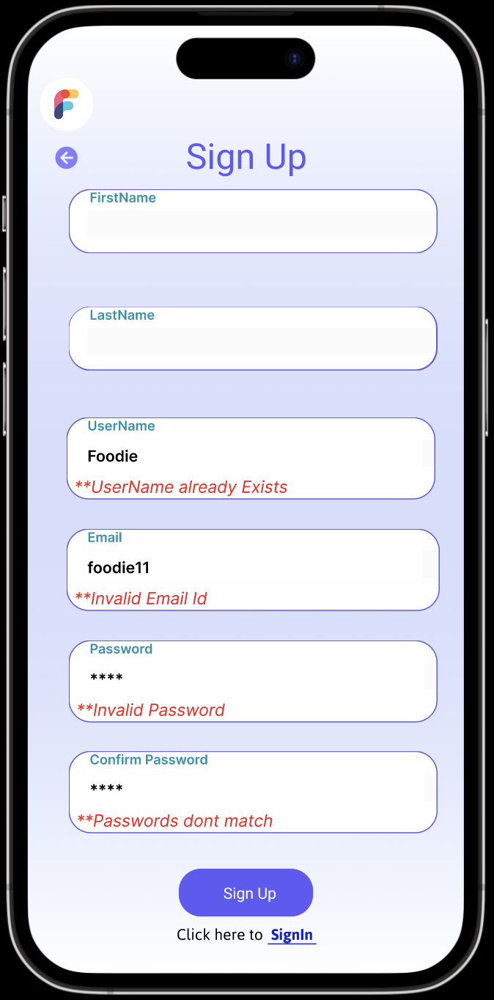
If user presses key ‘W’, it would show the error messages. For example, in real case scenario, if the username is incorrect, it would give an error message as ‘username already exists’.User needs to press ‘delete’ to get rid of the error.
The ‘V’ key represents the correct information. And once you press ‘Enter’, it would go to next value.

Slide 38

Usability Testing Objectives & Tasks

Slide 39
USABILITY TESTING - FOOD TALES APPLICATION
USERS | Can you navigate through platform to search restaurants,cuisines and recipes? | Can you refer to blogs to check out new restaurants,description of recipes etc | Can you leverage the blogs to promote content creation(photography)/review work? | Can you browse through blogs in the application
USER1 | The navigational flow is intuitive and easy to follow | One of the most helpful features to use in the application | As a content consumer, the feature has helped me to get introduced to and follow bloggers for better insight | Easy and convenient
USER2 | The search process is seamless | The feature helps to narrow down to best available options as per user needs | The feature has helped me reach out to people better and understand the trends in content consumption | It is easy and quick since users do not have to be signed in to browse blogs
USER3 | The functionality is similar to other web applications which enables to search | As a fitness enthusiast, this feature in the app helps me to follow and share healthy recipes and food options to my friends and family | The feature has helped to follow bloggers or find recipes/restaurants that prompt healthy food consumption | It has enabled me to use the app as a quick resource to search recipes/restaurants etc

Slide 40
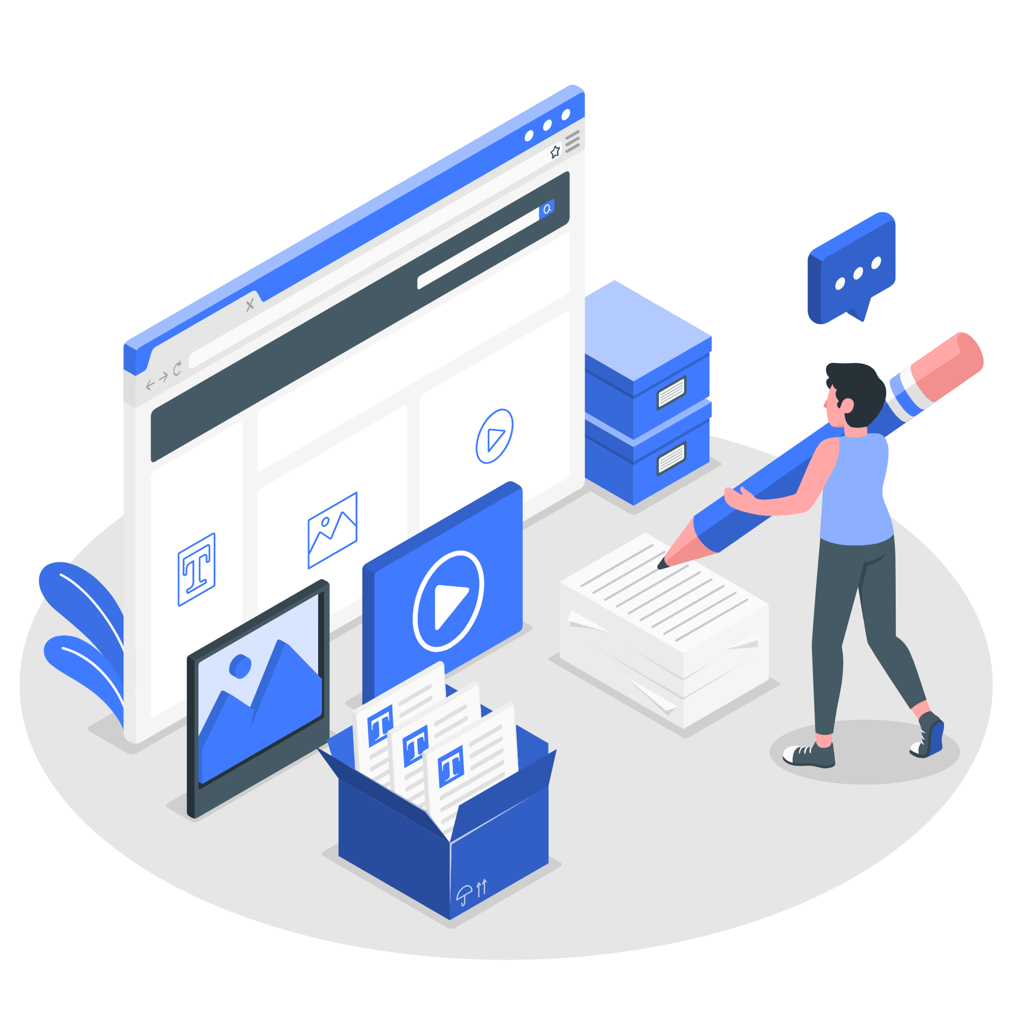
Five Planes of UX Design

Slide 41
Surface
Plane
In Surface Plane, we focused on the visuals and the look and feel of the application. App logo for Home navigation, material design vectors for seamless navigation, tab navigation, appropriate arrow guides, illustrations on sign up/sign in page.
Skeleton
Plane
For Skeleton Plane, we brainstormed on the overall flow throughout the app. Navigation menu at the bottom for ease of access, logo on top-left corner (easy to locate), user’s current location with appropriate vector on top-right corner. Then we started working on wireframes to get the initial look of the app.
Structure
Plane
In Structure Plane, we focused on the information architecture of the application. We did the initial card sorting during this phase to decide how features will be grouped. We also worked on error handling of various user input fields and user transactions.
Scope Plane
In Scope Plane, we learned how to convert the product objectives and user needs into app features. We prioritized the features using the MosCow approach.
In Strategy Plane, we focused on the frustrations using the User Personas and focused on working towards the user goals. Using the Surveys research method, we were able to gather data about user’s expectations for a food blog app.
Strategy Plane

Slide 42
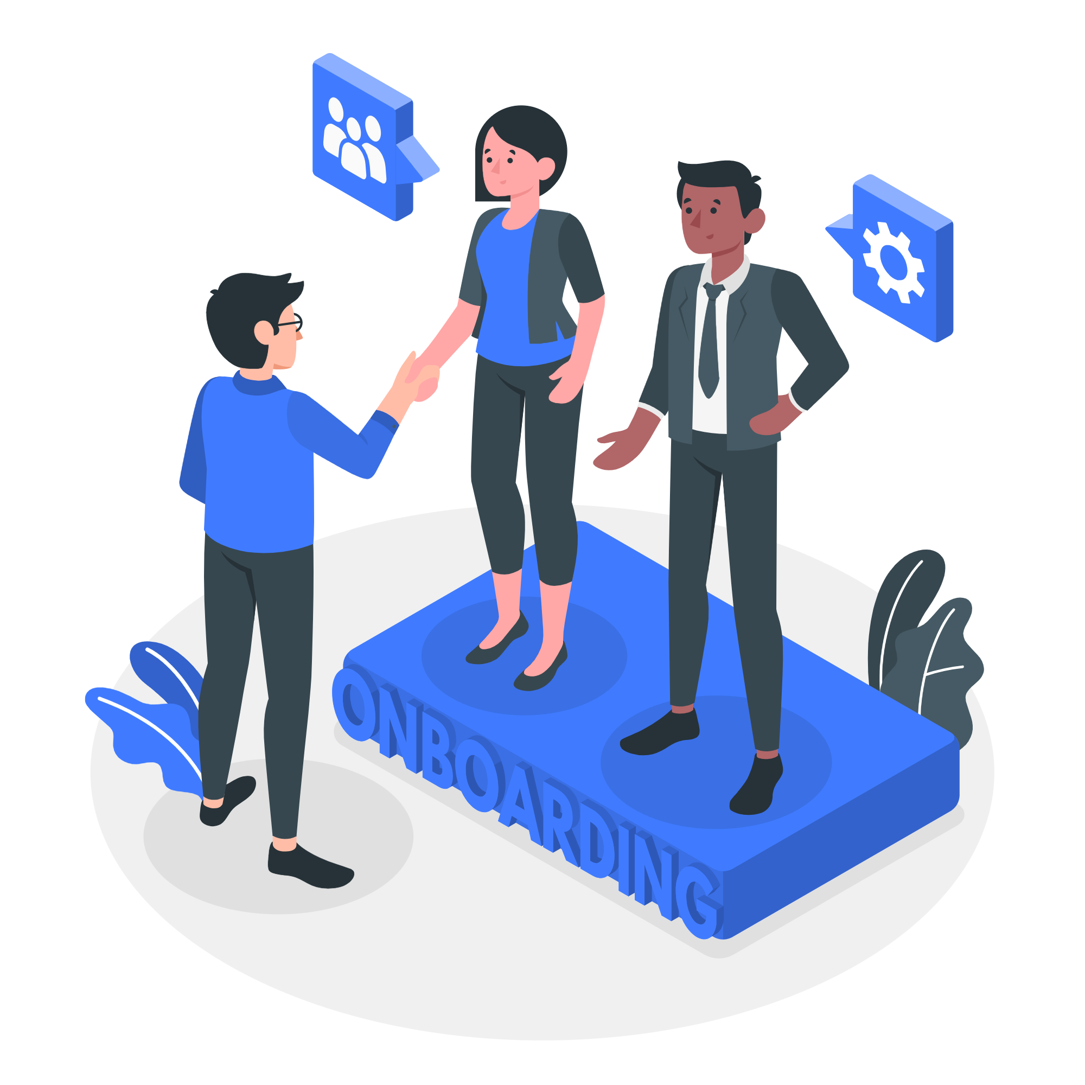
Onboarding

Slide 43

Onboarding is an important aspect to make new users familiar to the product. If the product appears too confusing or have minimal guide, it might frustrate the users resulting in user loss. ​
​
In our application, we have provided a quick navigation tour to familiarize users with app features after they sign up.
Explore Restaurants​
Create,View & Share Blogs​
Read Popular Recipes Reviews​

Slide 44
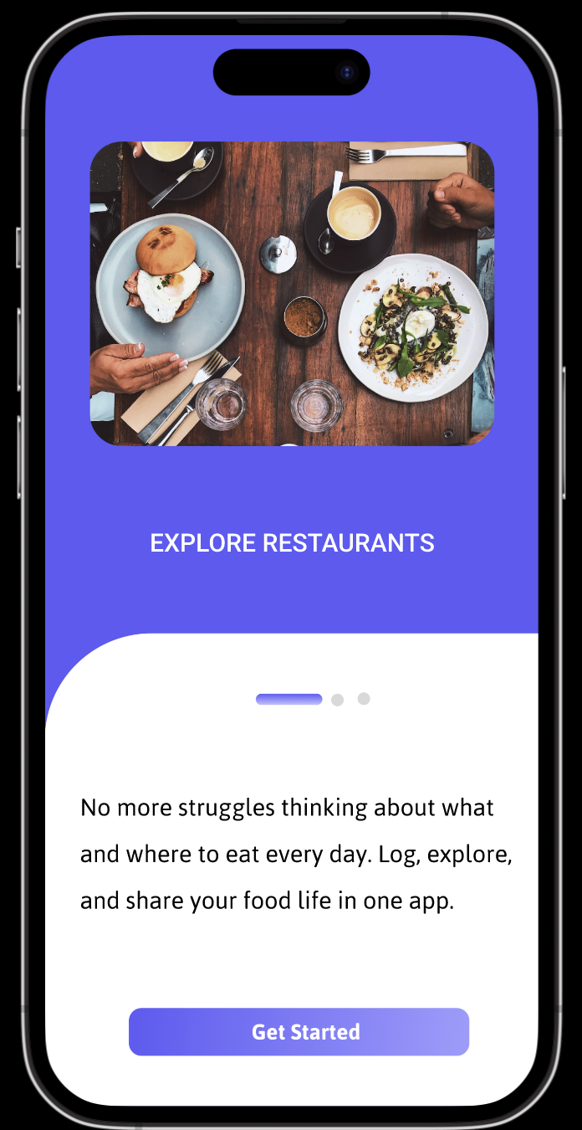
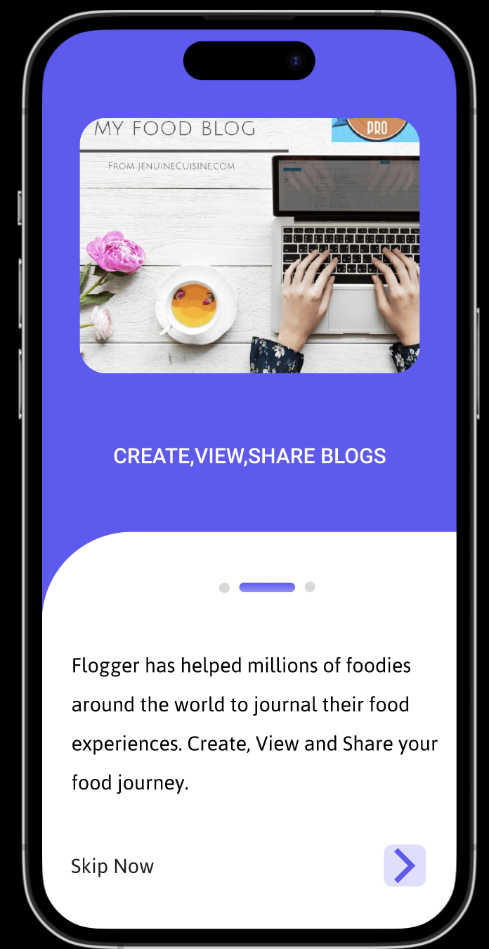
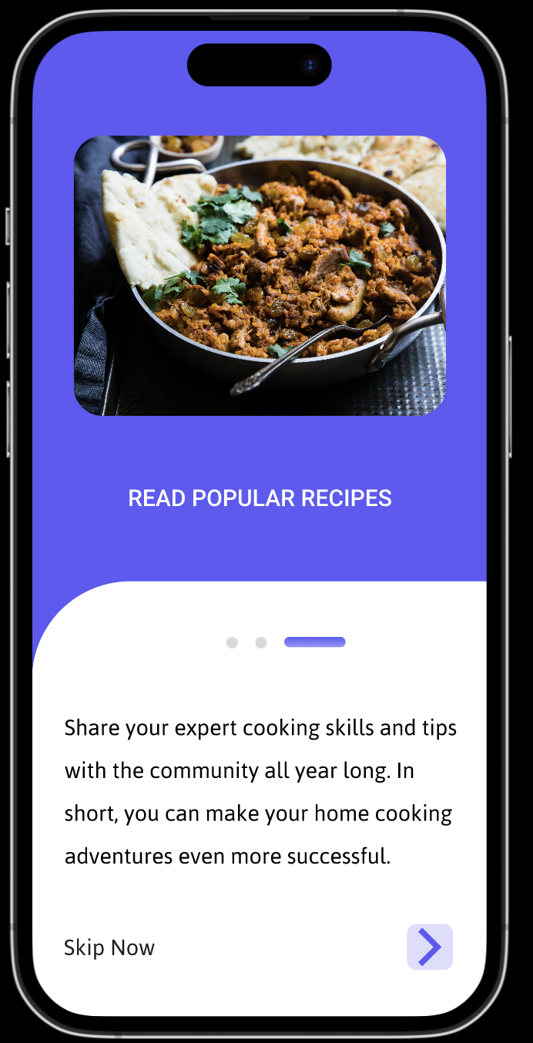
ONBOARDING - SCREENSHOTS

Slide 45
Thank You!

